Slide 1
2D Quadrilateral FE Poisson and DG Advection Solvers for Plasma Simulation
Tal Rubin
May 2020

Slide 2
Agenda
Motivation
Equations
Algorithms
Some Results

Slide 3
Motivation
Coupled Fluid and Maxwell solvers
Plasma is a state of matter in which an ionized gaseous substance becomes highly electrically conductive to the point that long-range electric and magnetic fields dominate the behavior of the matter. [Wikipedia]
Full system of equations for the time evolution of plasma are the Maxwell-Vlasov equations.
Vlasov -> distribution function, 6d phase space + time
Alternatively, taking moments of the Vlasov equation(s)
0th moment: Continuity equation
1st moment: Momentum equation
2nd moment: Energy equation, and so forth
Fluid solvers are popular alternative to Vlasov Solvers

Slide 4
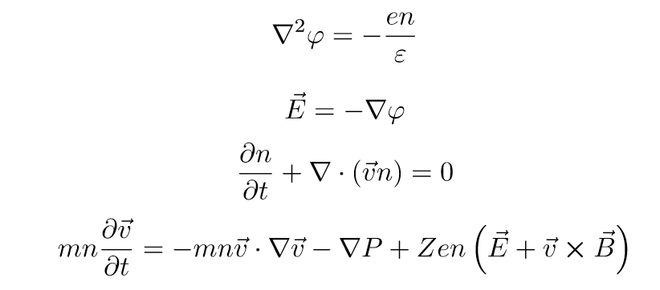
Equations for this project
1st Maxwell equation, 0th and 1st moments of Vlasov equation
The Poisson equation and relates the difference between the electron set to zero here and ion densities to electric potential, which produces electric field.
The electric field appears on the right-hand-side of the momentum equation as a forcing term.
Most of the time ions are conserved.
Poisson equation:
2D geometries could be complicated, its useful to be able to take spatial complexities into account.
Conservation equations:
Stability issues, positivity and monotonicity preservation.

Slide 5
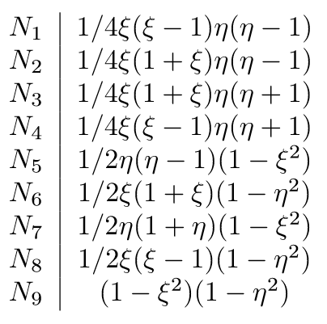
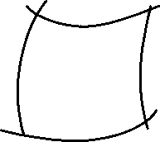
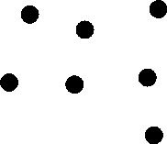
Finite Element Solver for the Potential
Quadrilateral Finite Elements
4
3
7
The finite-element method is able to capture complex multidimensional geometry by dividing space into elements.
The elements implemented here are 2D quadrilaterals with 9 Lagrange nodes.
These element are deformable and can exactly match the boundaries of domains that can be locally parametrized by 2nd order polynomials.
The solution generated by these elements is composed of some of piecewise 2nd degree polynomials.
I used Dirichlet boundary conditions of grounded walls.
8
6
9
2
1
5

Slide 6


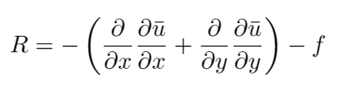
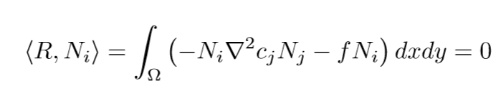



Finite Element Solver for the Potential
Weak-Form formulation of PDE
For the differential equation:
An approximate solution in the form:
The residual:
Minimizing the projection of the residual on each test function:
Is equivalent to solving a system of linear equations:

Slide 7

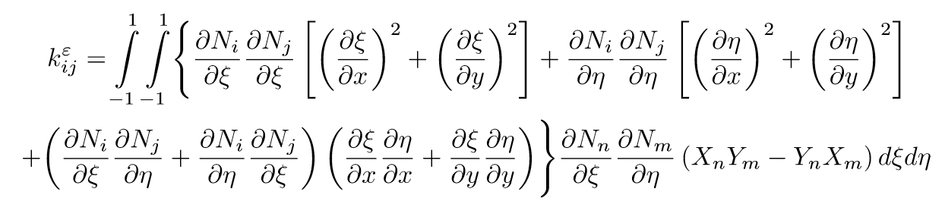
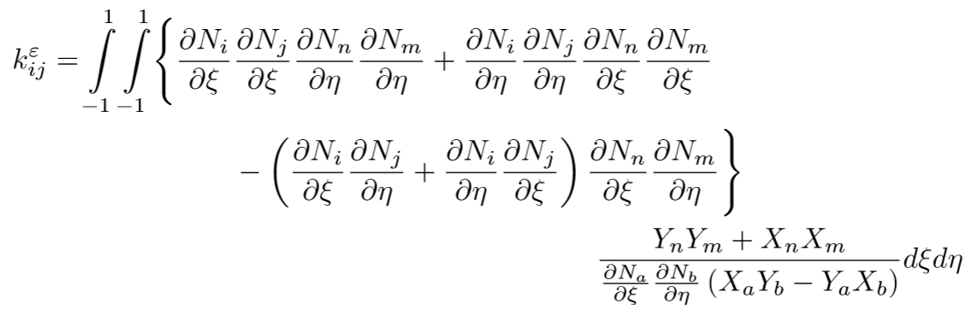
Finite Element Solver for the Potential
Calculating the Integrals
Its useful to have a uniform integral to solve, so a change of variables is made, with the vector N the vector of basis functions.
The stiffness matrix element becomes:
Or, using known functions:
Since this integral contains the inverse of a polynomial, it is evaluated by Gauss Quadrature.

Slide 8
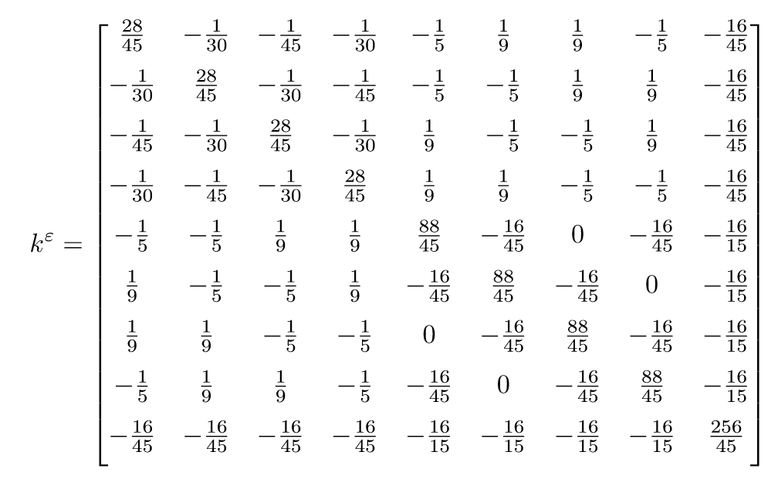
Finite Element Solver for the Potential
Calculating the Integrals
The stiffness matrix for each element for a regular grid.

Slide 9

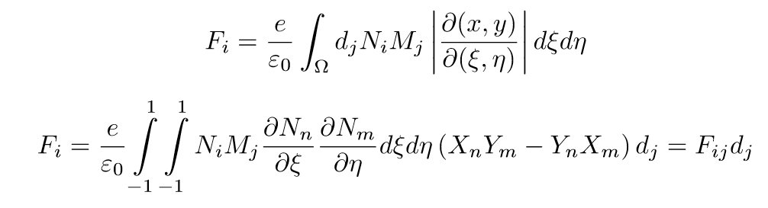


Finite Element Solver for the Potential
Calculating the Integrals
For F, we need the ion density, which is approximated using a different set of basis functions.
Since this time we have an integral of a polynomial we evaluate it analytically
For this I wrote a class that handles 2D polynomials analytically.
Since the potential quasi-static (under my assumptions), the matrices and are calculated only once.

Slide 10
Finite Element Solver for the Potential
Code structure
Polynomial2d
Defines the class poly – handles analytically 2d polynomials
Addition, multiplication, differentiation and integration, and representation in python and tex forms.
Quadratic_Poly_Functions
Defines the basis functions for the elements
PreProc
Pre-Processor, handles domain definition, division into elements, and matrix assembly.
Returns a table of elements, list of node positions, stiffness and force matrices.
Solver
Uses numpy to solve the linear system of equation.

Slide 11
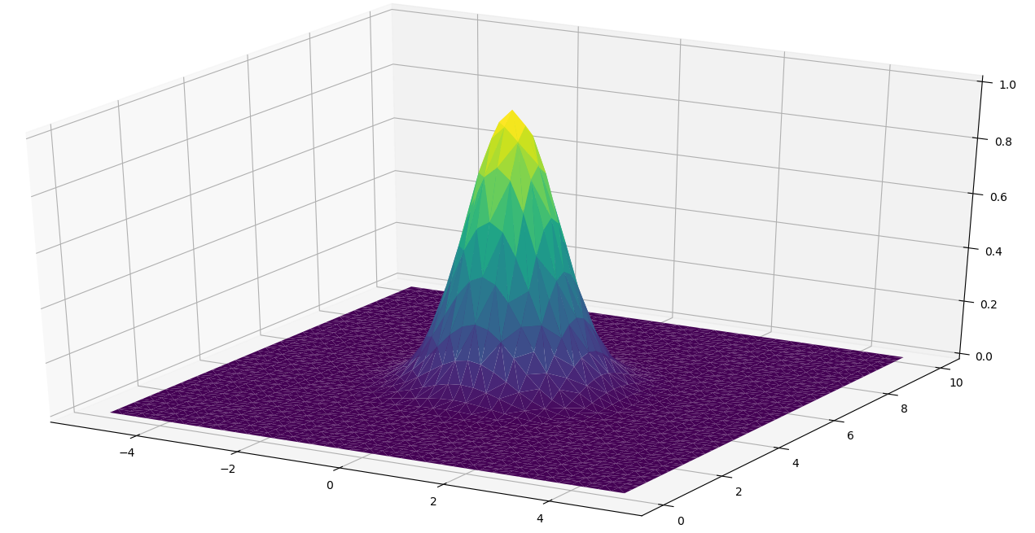
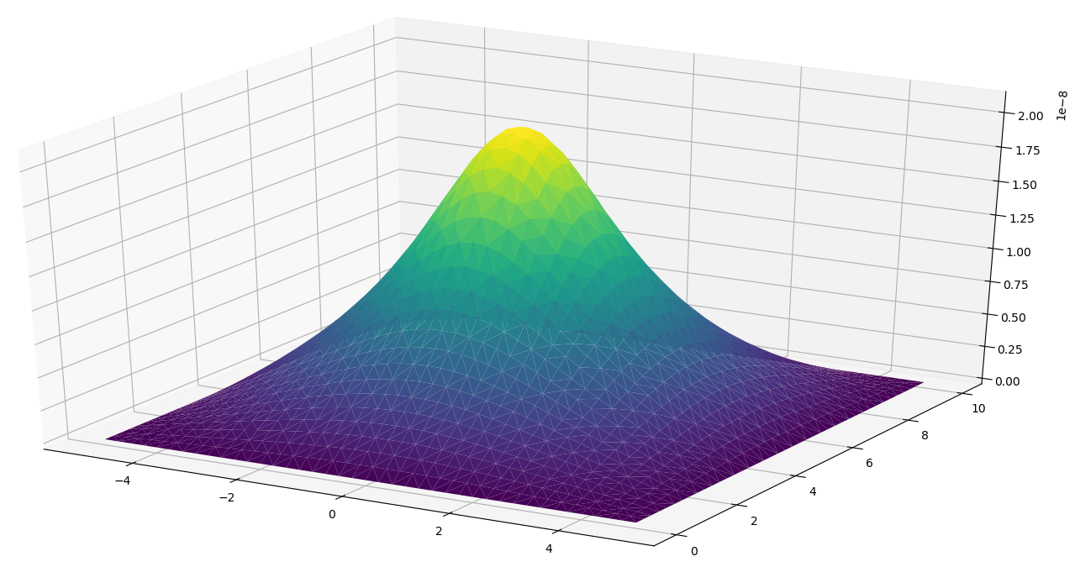
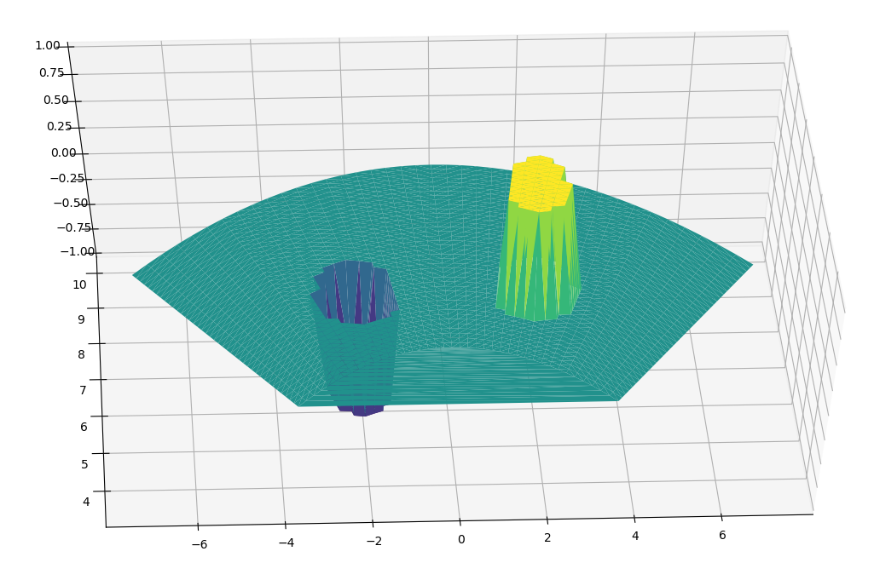
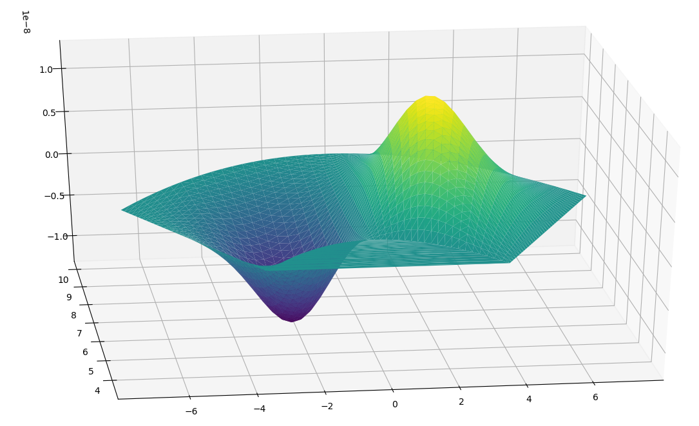
Finite Element Solver for the Potential – Some Results
density
potential

Slide 12
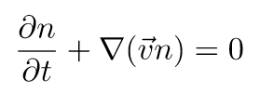
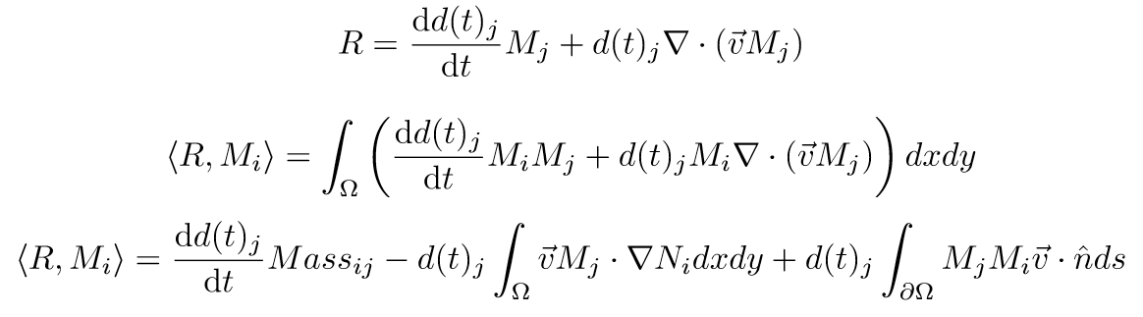
Discontinuous Galerkin Solver for Advection
Weak-Form formulation of PDE
Same steps as for FE:
With Legendre Polynomials basis functions.

Slide 13
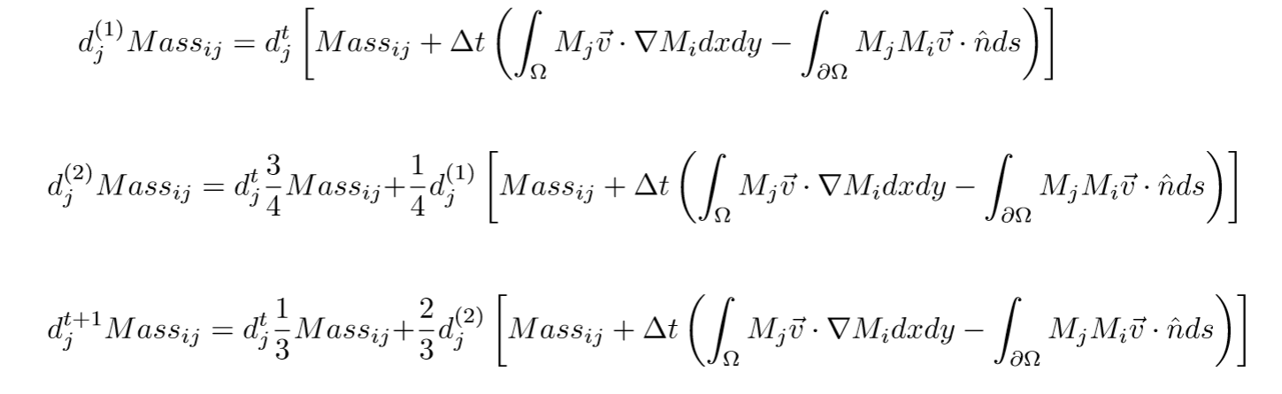
Discontinuous Galerkin Solver for Advection
Time solution
Since we use quadratic functions in space, we need 3rd order RK in time:

Slide 14
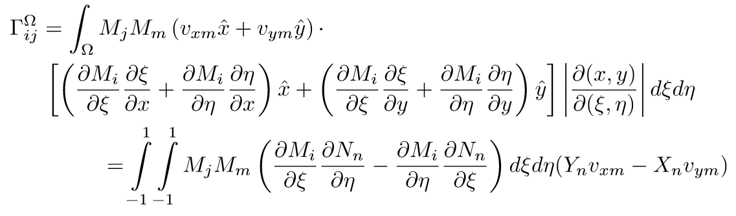
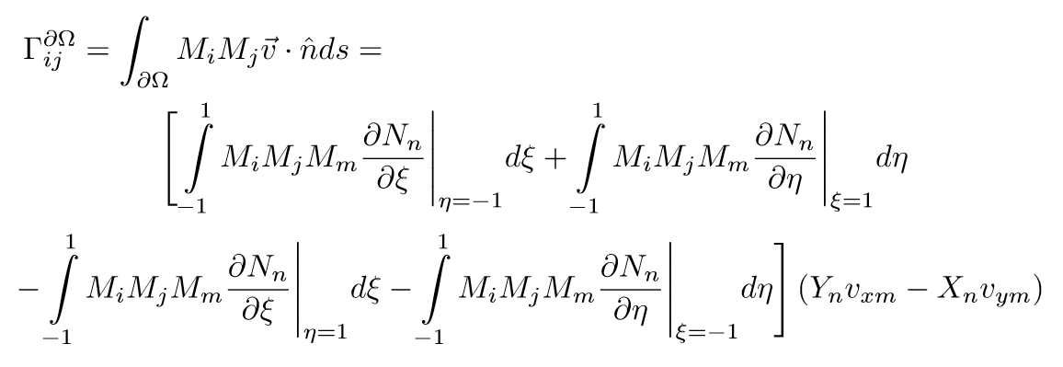
Discontinuous Galerkin Solver for Advection
Calculating the Integrals
The flux matrix within each element:
The flux matrix out of the element:

Slide 15
Discontinuous Galerkin Solver for Advection
Numerical Flux
Since the fluxes out of each side of the element generally don’t agree, we use a “numerical flux” to approximate the real flux.
The flux at each element boundary is set to be the average between the fluxes calculated for the solution in each side of the boundary.
Lax–Friedrichs numerical dissipation could be added.

Slide 16
Questions?

